Slide 1
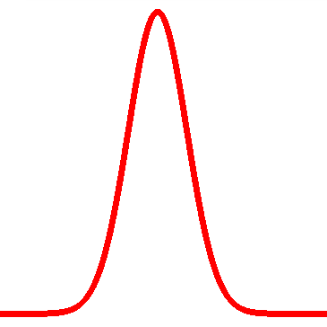
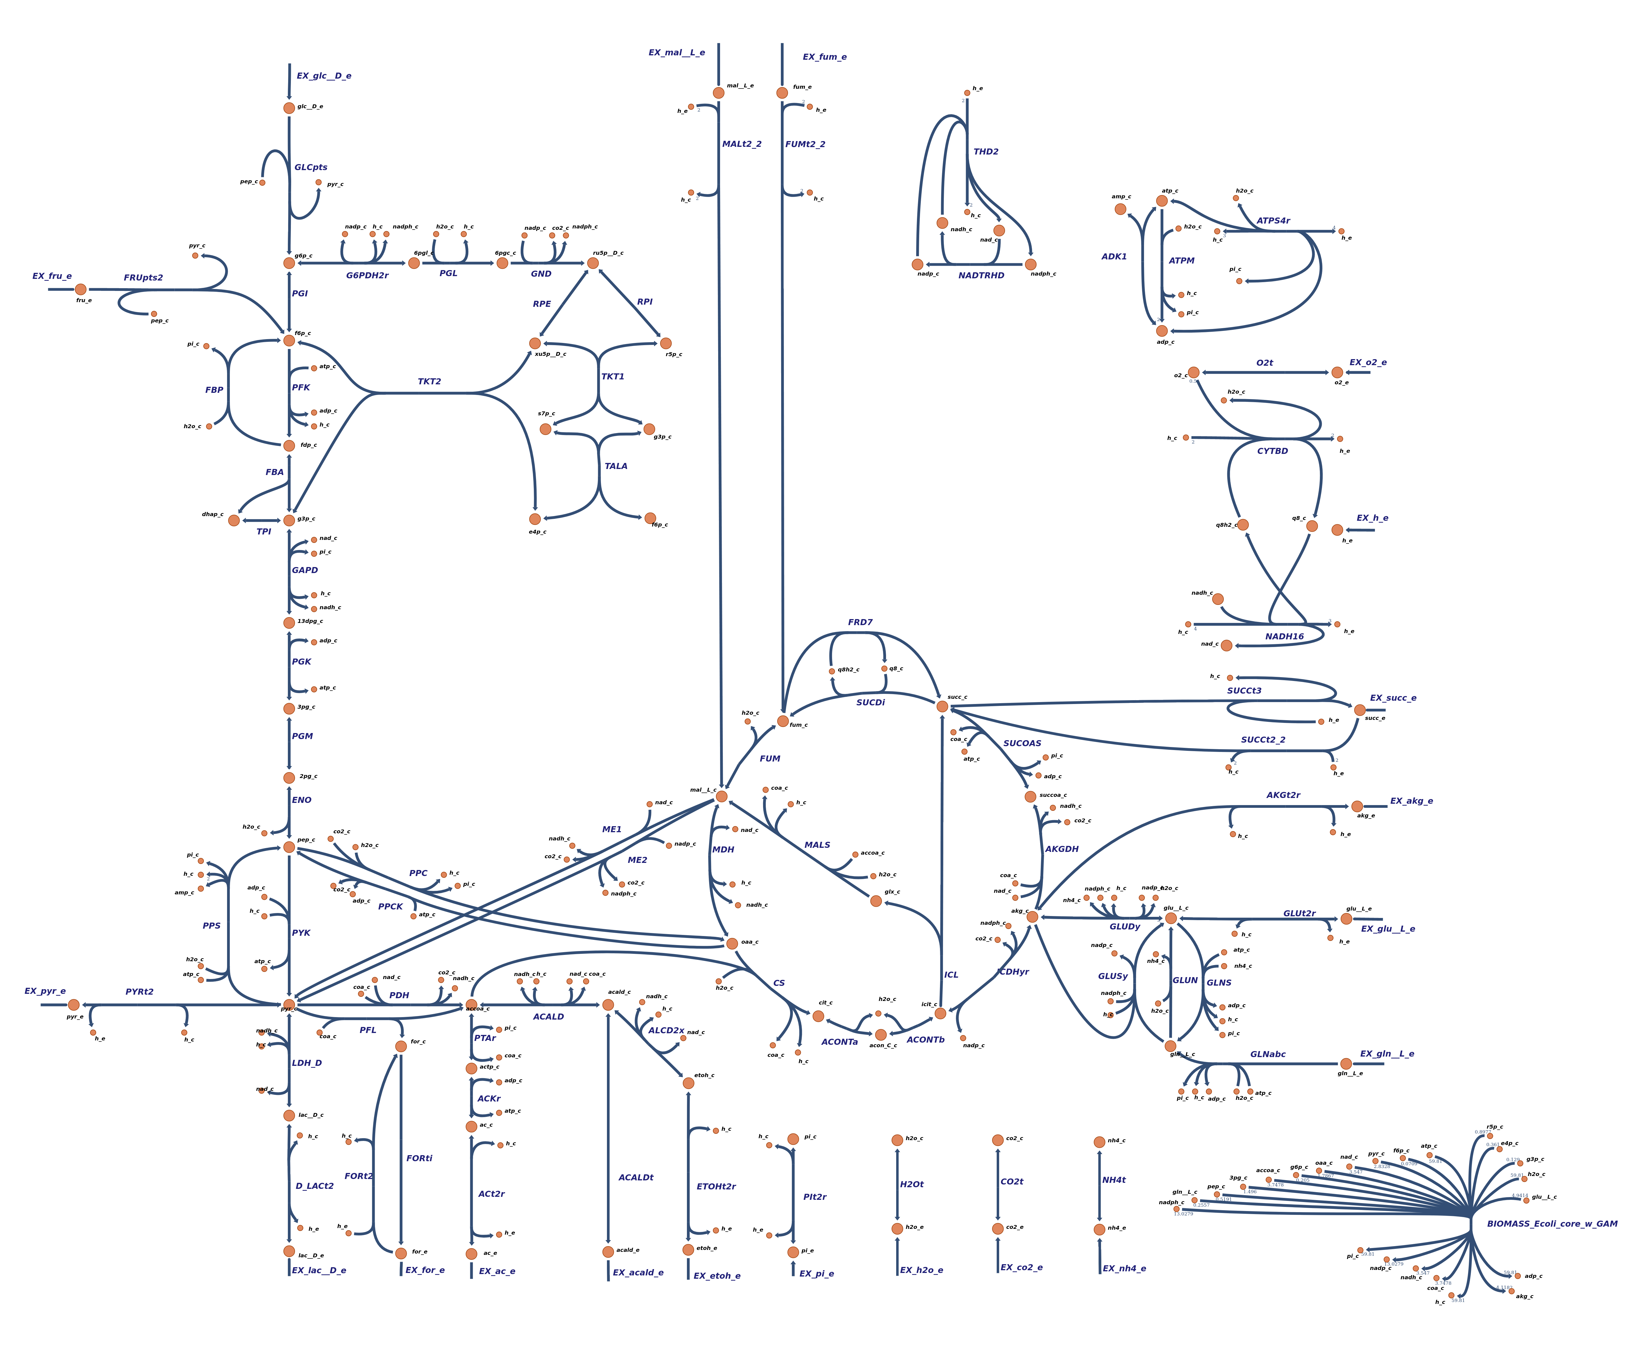
BADASSS : Biological Analysis Designed for A Steady-State System
Mutual information analysis
MCA model
Steady-state system
Metabolic network

Slide 2
.Stoichio_matrix
Architecture of the module
.metabolites
.add() .remove() .df
.reactions
.add() .remove() .df
.parameters
.add() .remove() .add_enzyme() .add_ext()
.df
model
.elasticities
.half_satured()
.s .p
.enzyme
.add() .remove() .add_to_all_reaction() .df
.regulation
.add() .df
.rho() .MI() .plot()
.data_sampling .sampling()
class
.check() .reset()
function
attribute
.creat_linear() .read_SBML() .read_CSV()

Slide 3
Computational cost of the Mutual Information search
M metabolites
R réactions
P parameters
Name | Type | Dimensions
Jacobian : J = N.ε | 1 Matrices product | M x R . R x M
J inversion | 1 Matrice Inversion | M x M
 | 2 Matrices products
 | 1 Matrices product
Covarice matrix | 2 Matrice products 2 Matrices transpositions
Computation of MI | 1 by 1 operation on each elements | Can be modified

